Slide 1
Dynamic Soft Impacts
Week 5

Slide 2
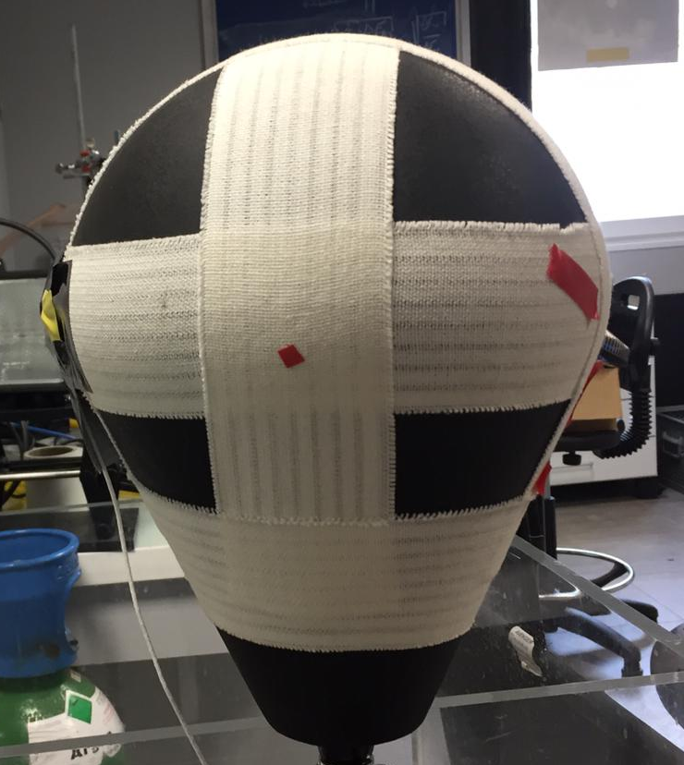
Back to the Punching Ball
Test comparing camera and accelerometer at rear of punching ball
Measured one point at rear and one point at centre with camera
impact
Camera rear point
+ Accelerometer
Camera mid point

Slide 3
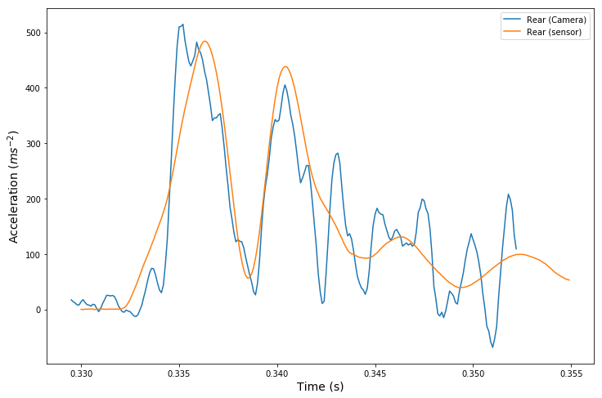
Results

Slide 4
Why?
Established propagation of shockwave in soft media
Did not observe double peaks in static soft impacts
New experiment to see if addition of centre of mass translation will reveal double peaks

Slide 5
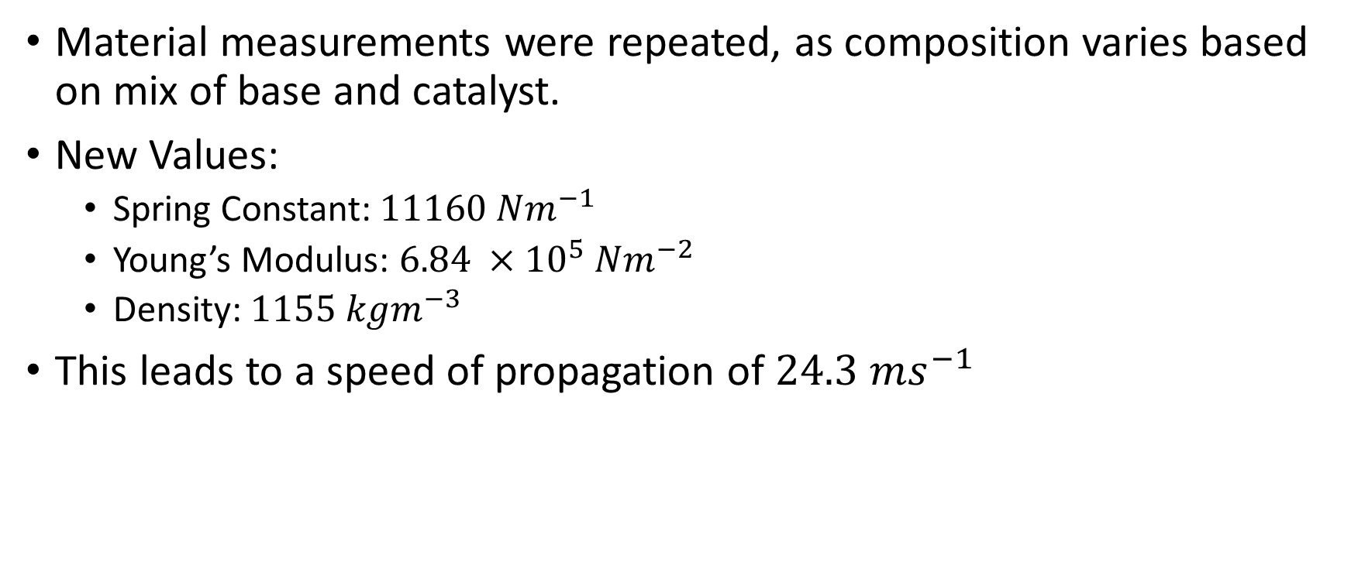
New block of dentist paste
Material measurements were repeated, as composition varies based on mix of base and catalyst.
New Values:
Spring Constant: $11160 Nm^{−1}$
Young’s Modulus: $6.84 ×{10}^{5} Nm^{−2}$
Density: $1155 kgm^{−3}$
This leads to a speed of propagation of $24.3 ms^{−1}$

Slide 6
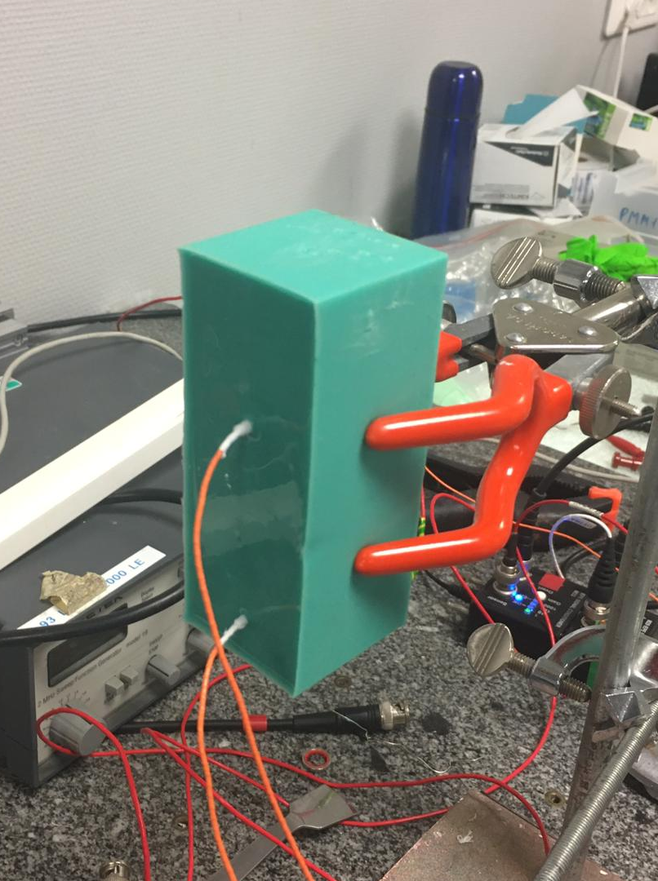
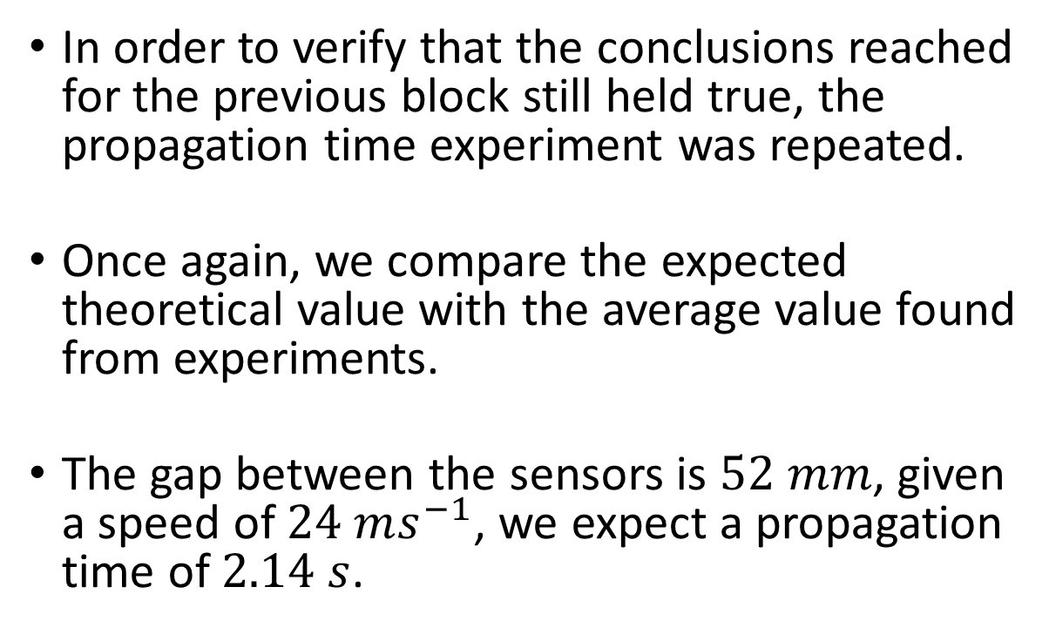
Repeat of previous experiment
Impact
In order to verify that the conclusions reached for the previous block still held true, the propagation time experiment was repeated.
Once again, we compare the expected theoretical value with the average value found from experiments.
The gap between the sensors is $52 mm$, given a speed of $24 ms^{−1}$, we expect a propagation time of $2.14 s$.

Slide 7
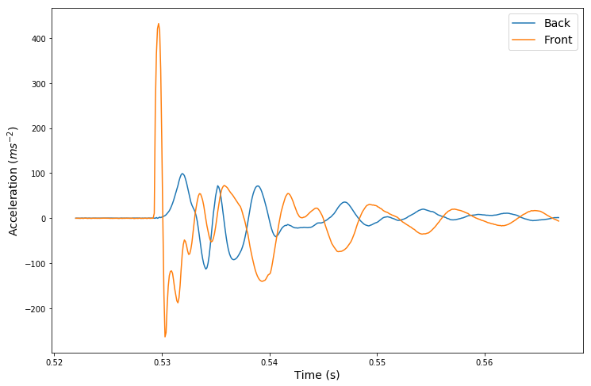
Example data

Slide 8
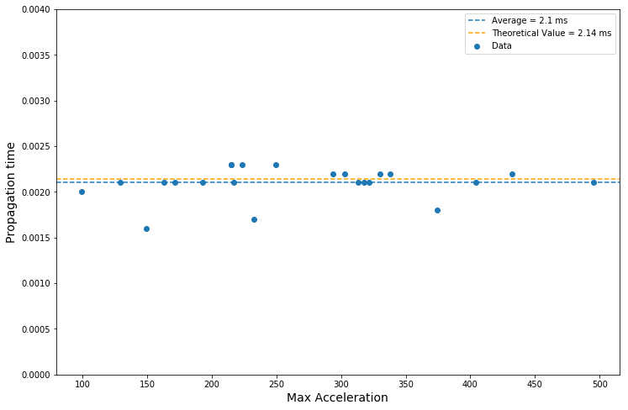
Results

Slide 9
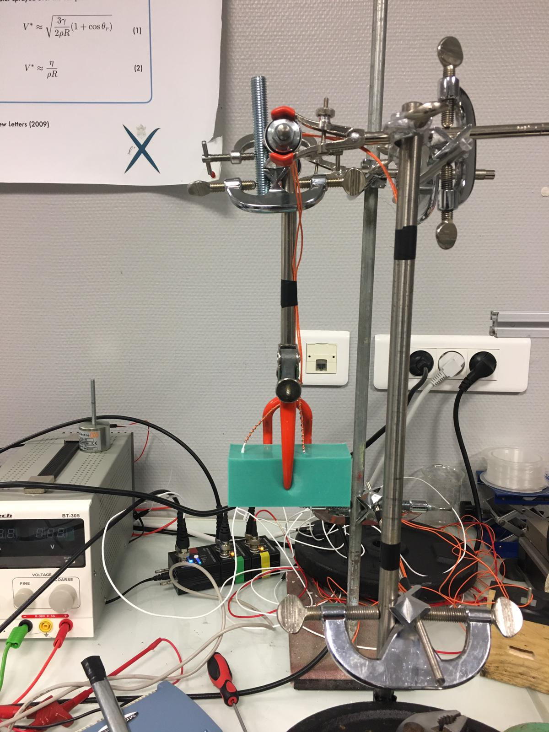
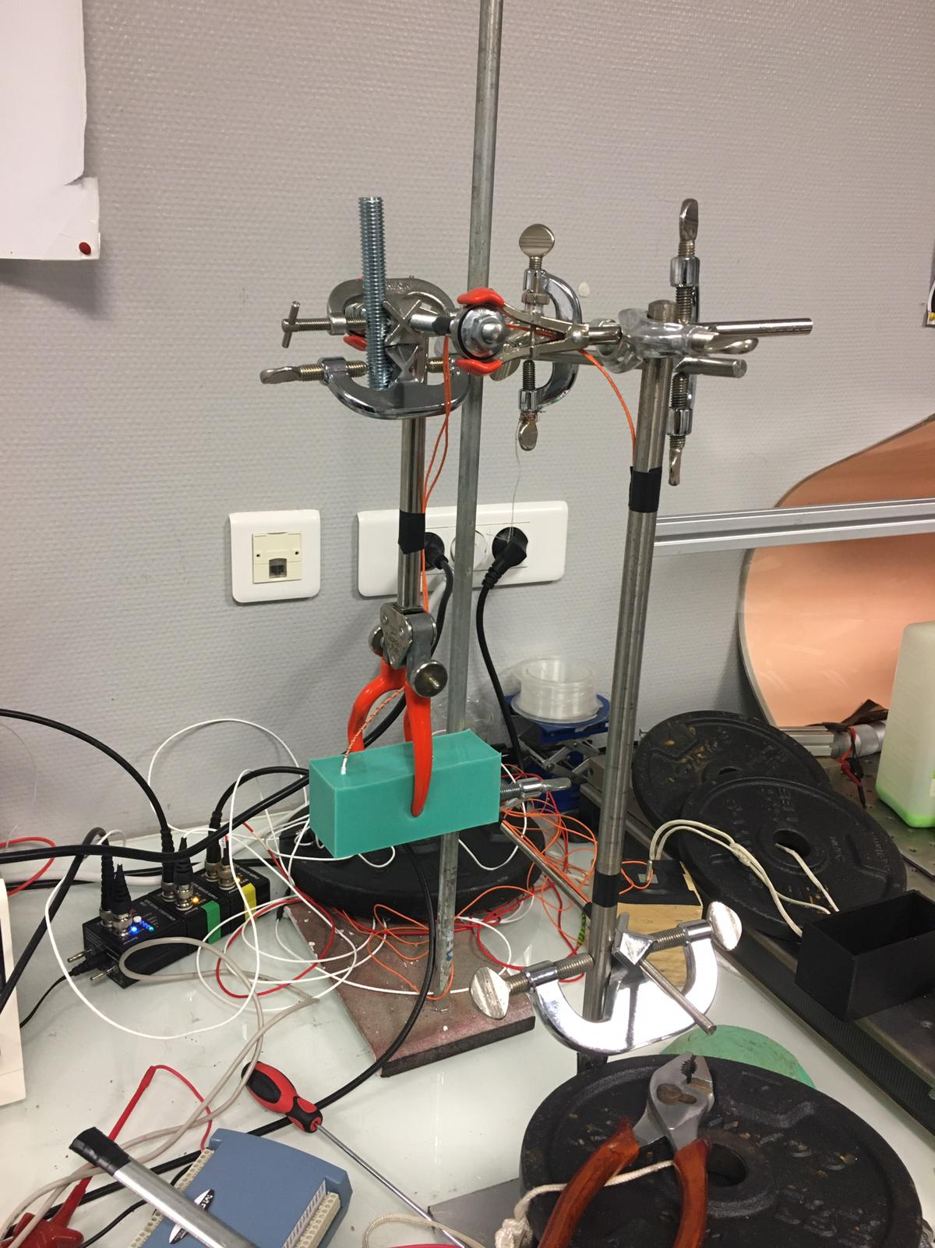
New Experimental Set up
Impact

Slide 10
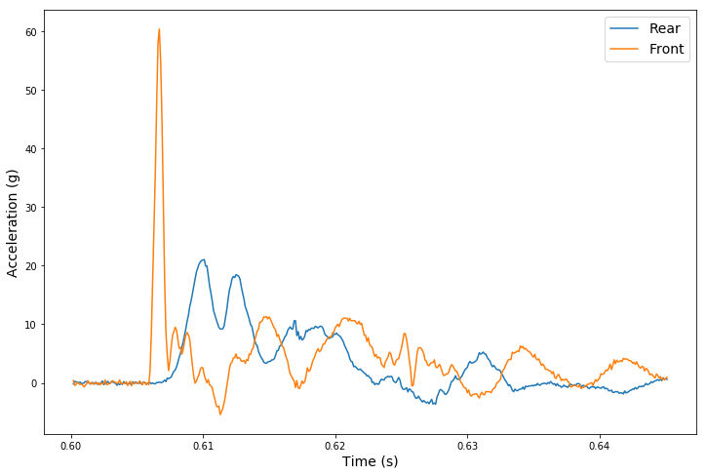
Example data

Slide 11
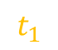
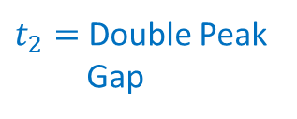
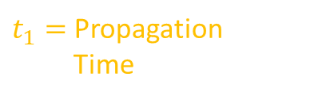
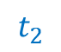
Example data
$$t_{1}$$
$$t_{2}$$
$t_{1}=$ Propagation
Time
$t_{2}=$Double Peak
Gap

Slide 12
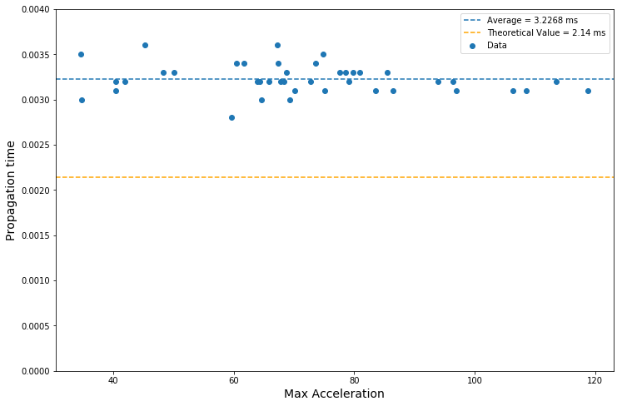
Results – Propagation Time

Slide 13
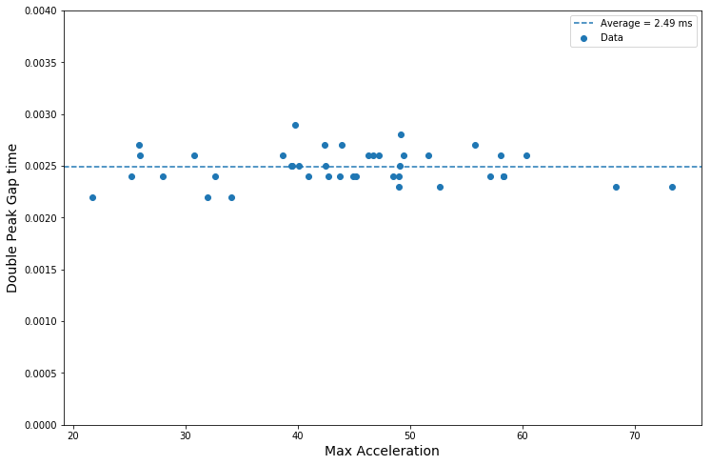
Results – Double Peaks

Slide 14
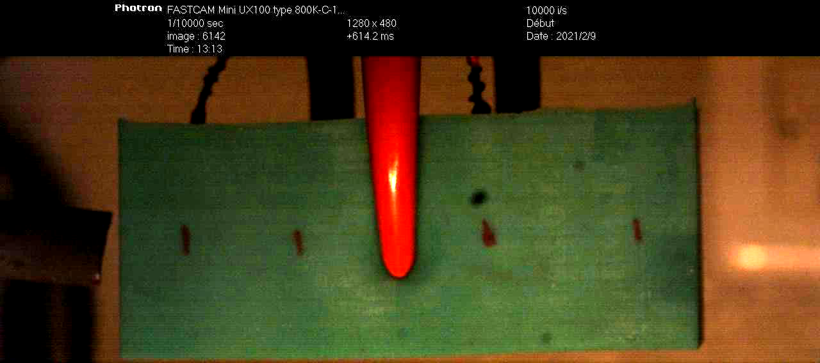
Video Analysis

Slide 15
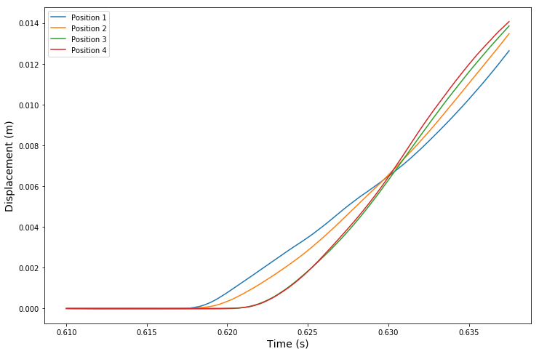
Positions from videos

Slide 16
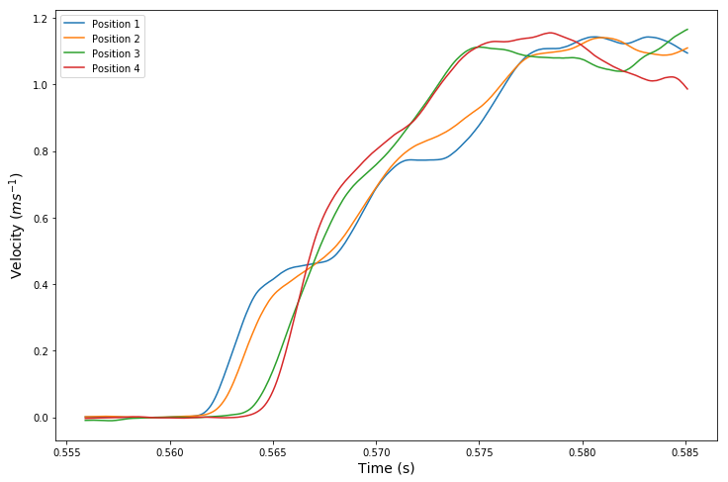
Velocities from Videos

Slide 17
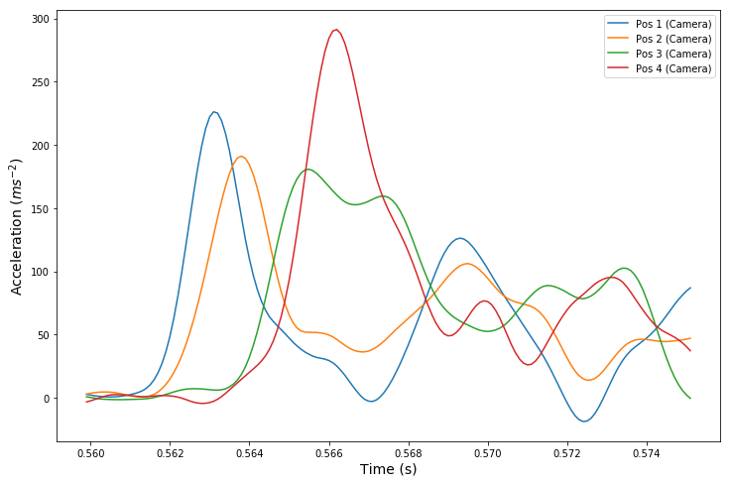
Accelerations from video
Double peak present in only one place, why?

Slide 18
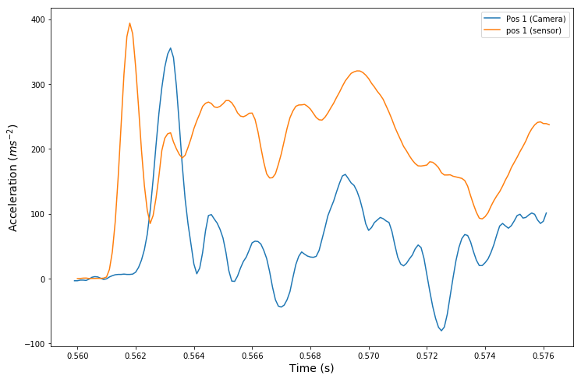
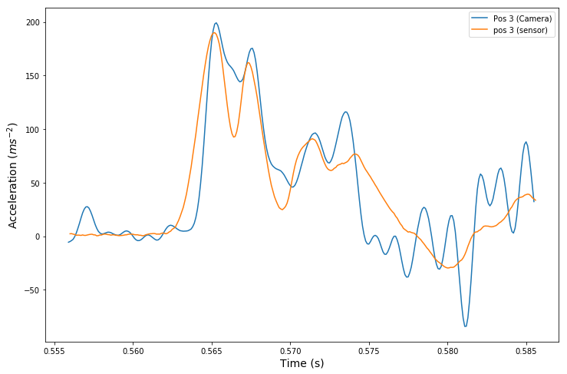
Cameras vs Sensors
Shift in time at first accelerometer (possibly due to spherical propagation of wave)
Very good agreement at second accelerometer

Slide 19
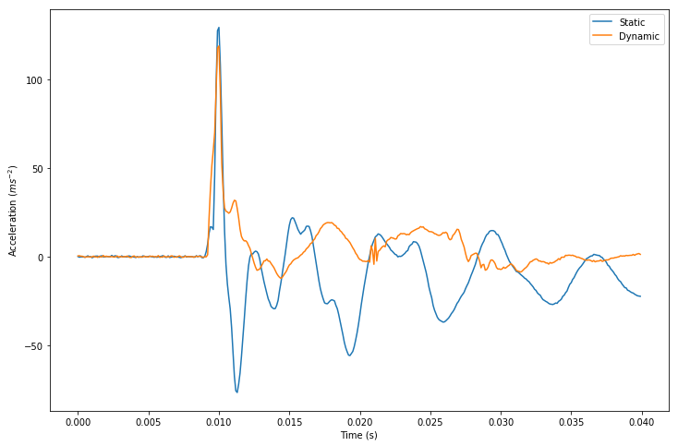
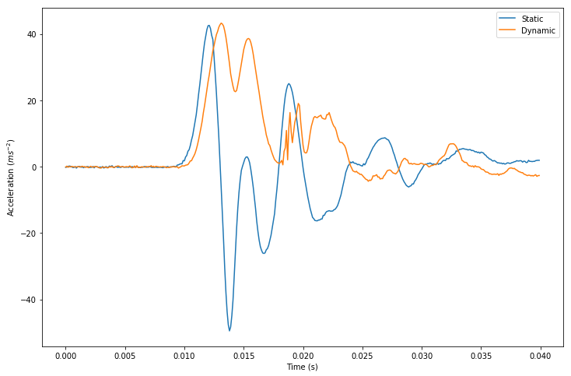
Static vs Dynamic
A small shift in time – Corresponding to a difference in propagation time
A large shift in acceleration – Corresponding to acceleration of centre of mass??

Slide 20
Static vs Dynamic
A small shift in time – Corresponding to a difference in propagation time
A large shift in acceleration – Corresponding to acceleration of centre of mass??

Slide 21
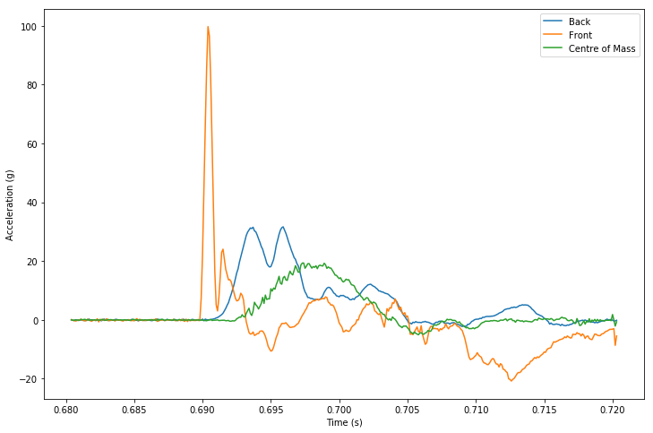
Adjustment for centre of Mass
Subtract acceleration of centre of mass.

Slide 22
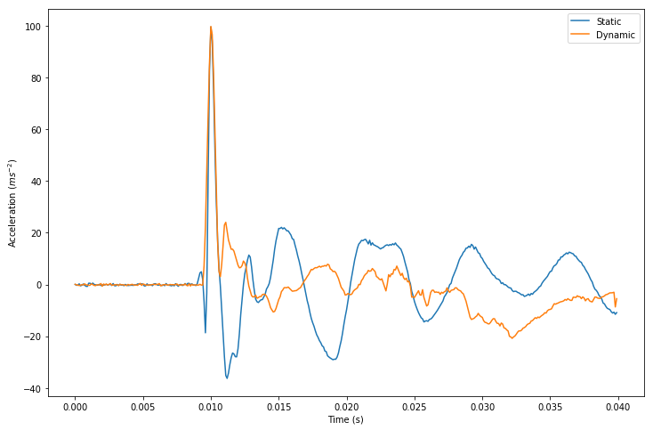
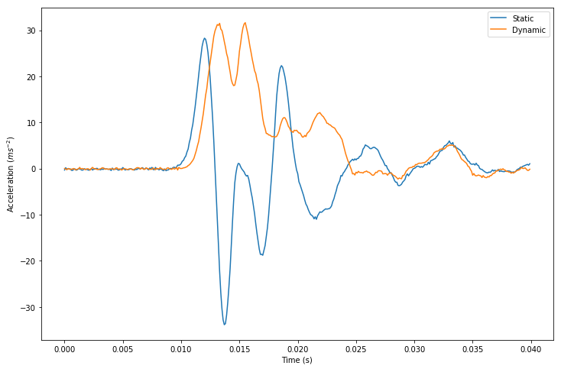
Adjustment for centre of Mass
Without Adjustment:

Slide 23
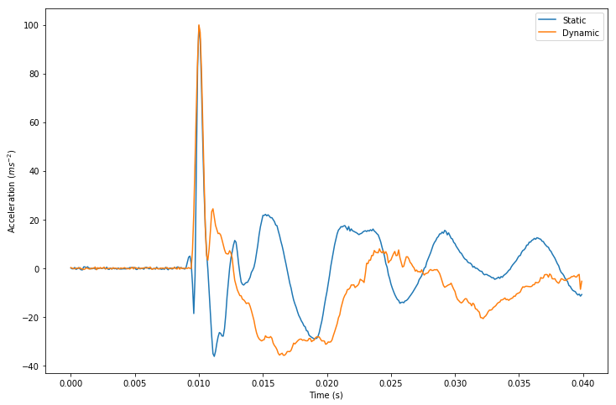
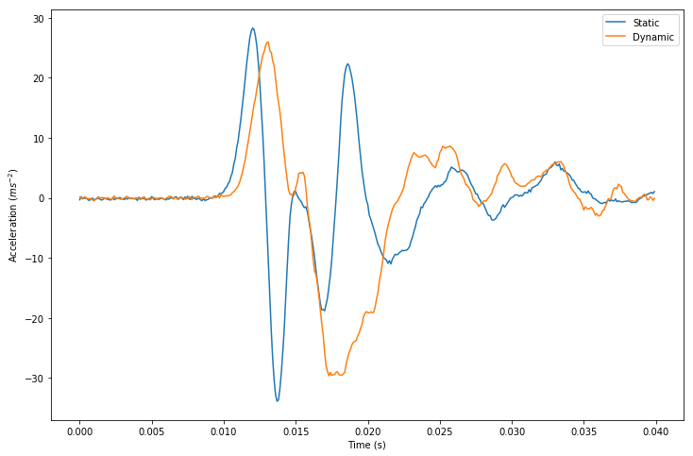
Adjustment for centre of Mass
With Adjustment:

Slide 24
Questions
Why change in propagation time? Due to clamp?
What is theoretical basis of double-peak time?

